Slide 1
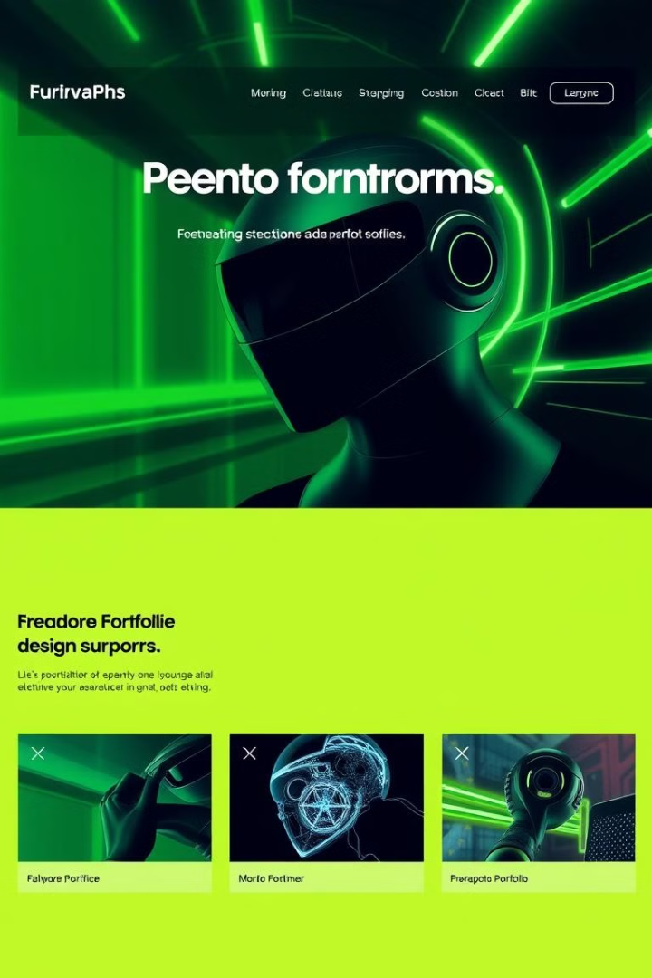

Styling a Basic Webpage: My Personal Webpage
In this project, I have applied CSS styles to enhance the appearance of my personal webpage. I've used a visually appealing design, strategic typography, and a cohesive color palette to create a polished and engaging online presence.
Made By : Gungun Jain
Roll No. : 2200290120071
Branch : CS
Sec : 5B

Slide 2

About the Project
1
Goal
2
Tools
Develop a visually stunning personal website that showcases my skills and personality.
Created using HTML, CSS, and JavaScript with the help of Visual Studio Code.
3
Approach
Iterative design and development process, focusing on user experience and responsive design.

Slide 3

HTML Structure of the Webpage
Semantic Elements
Accessibility
Modularity
Ensured proper use of alt tags, headings, and other accessibility best practices.
Divided the page into reusable components for easier maintenance and future updates.
Used HTML5 semantic elements like header, nav, main, and footer to create a well-organized structure.

Slide 4

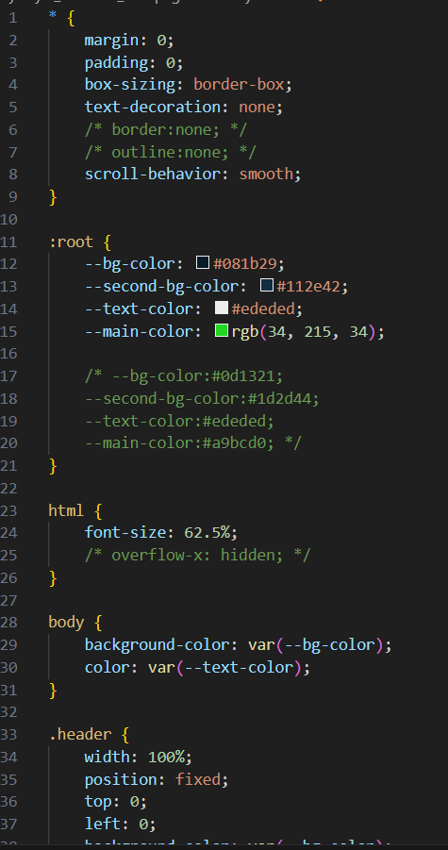
Applying CSS Styles
1
Layout
Used CSS Grid and Flexbox to create a responsive and visually appealing layout.
2
Styling
Applied styles for typography, colors, backgrounds, and other visual elements.
3
Animations
Added subtle CSS transitions and animations to enhance the user experience.

Slide 5
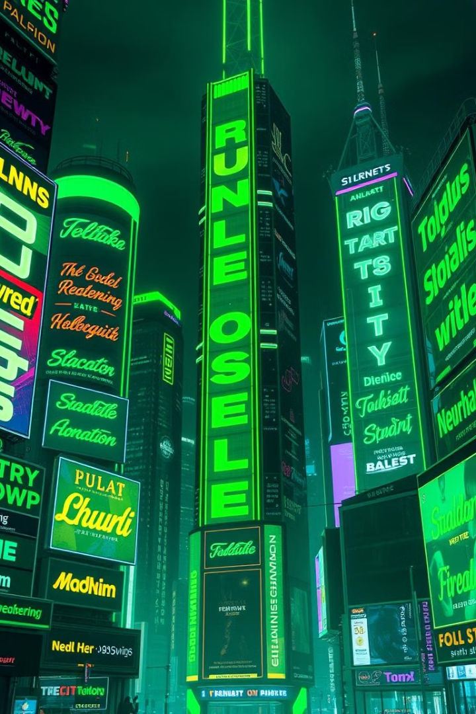

Typography and Color Palette
Typography
Color Palette
Chose a clean and modern font pairing that is easy to read and visually appealing.
Selected a harmonious color scheme that reflects my personal style and brand identity.
Consistency
Maintained consistency across the website to create a cohesive and professional look.

Slide 6
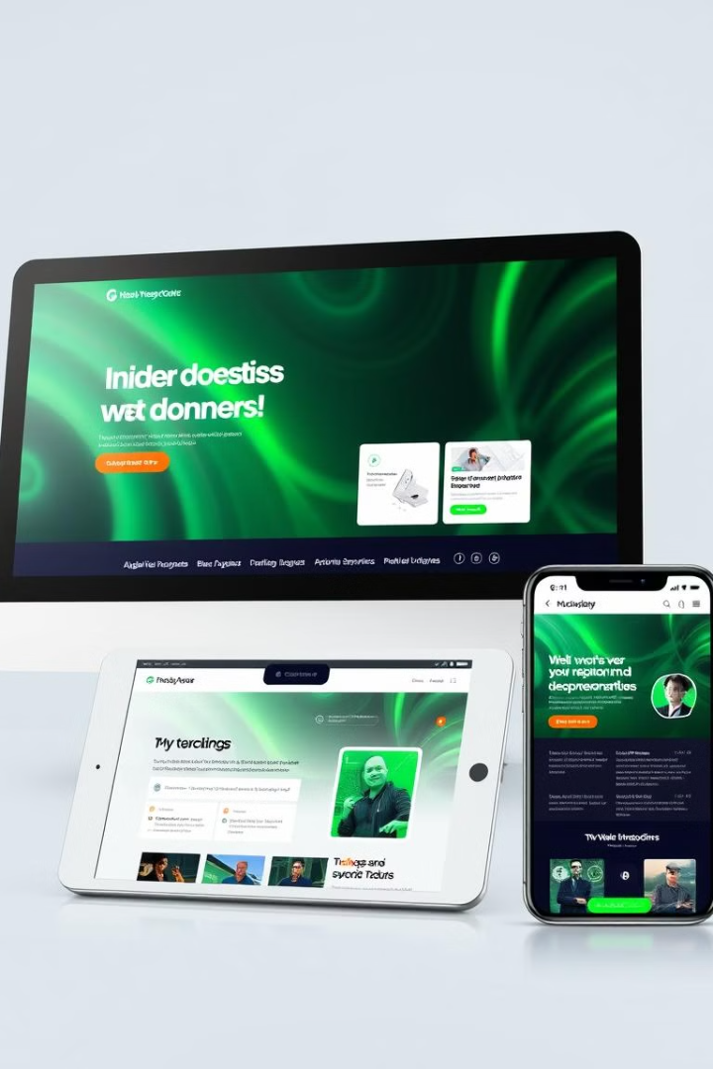




Responsive Design Consideration
Mobile-Friendly
Ensured the website looks great on a variety of mobile devices and screen sizes.
Tablet Compatibility
Optimized the layout and user experience for tablet devices and orientations.
Desktop Experience
Provided a seamless and visually appealing experience on larger desktop screens.

Slide 7
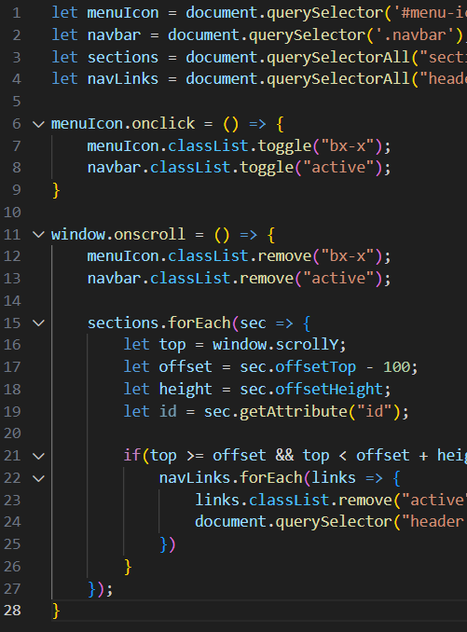
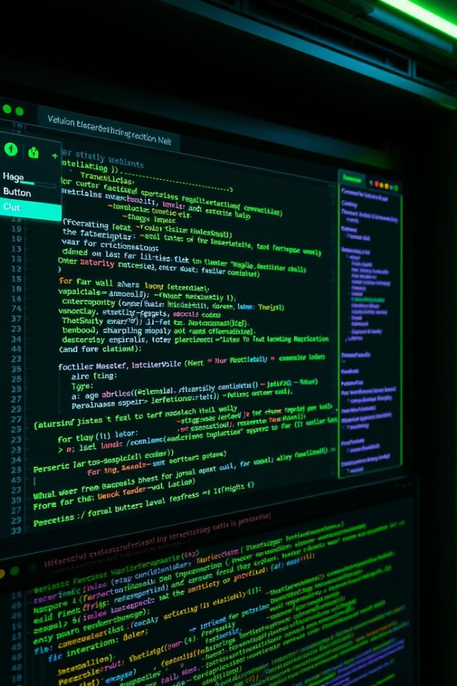



Enhancing with JavaScript
Interactivity
Added interactive features like navigation menus, image sliders, and form validation.
Dynamic Content
Used JavaScript to generate and update content dynamically, improving engagement.
Performance
Optimized JavaScript code for fast loading times and smooth user experiences.

Slide 8
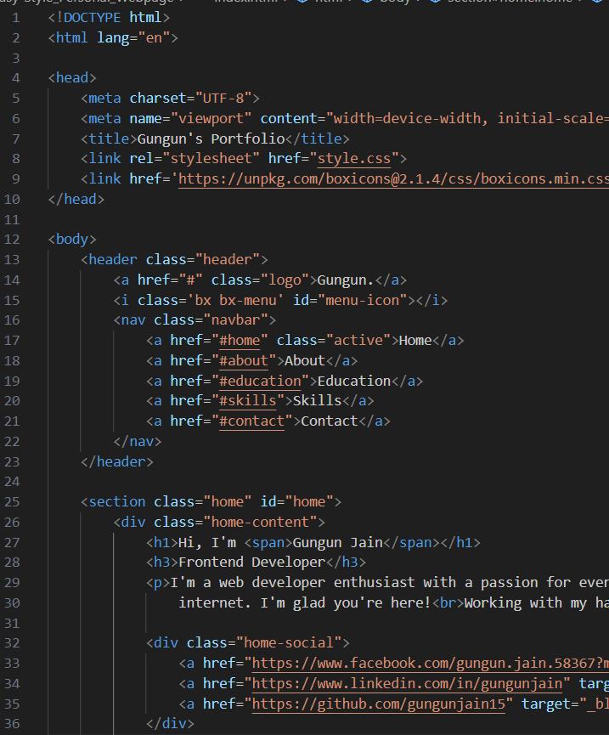


Challenges and Lessons Learned
Responsive Design
Ensuring the website works seamlessly across different devices and screen sizes was a key challenge.
CSS Complexity
Mastering advanced CSS techniques, like flexbox and grid layouts, took time and practice.
JavaScript Integration
Integrating JavaScript functionality while maintaining a clean and efficient codebase was an ongoing learning process.

Slide 9



Conclusion and Next Steps
1
Proud Outcome
2
Continuous Improvement
I'm thrilled with the final result and how the website represents my personal brand.
I plan to regularly update and enhance the website with new content and features.
3
Future Goals
Explore additional ways to engage visitors and showcase my skills and experience.

